Slide 1
Brief on AMD ROCm & MIVisionX
Alan Zhang

Slide 2
Summary
ROCm: AMD open-source HPC/Hyperscale-class platform for multiple GPU nodes' computing;
ROCm has been integrated into Tensorflow and PyTorch framework, also support heterogeneous-computing application development based on OpenVX, OpenCL, CUDA seamlessly;
MIVisionX toolkit is a comprehensive set of computer vision and machine intelligence libraries, utilities and applications bundled into a single toolkit.

Slide 3
Agenda
What is ROCm and its modules?
AMD AI over ROCm
MIVisionX Overview
MIVision Components - OpenVX, Neural Network Model Optimizer, Toolkit, and Utilities

Slide 4
AMD ROCm 2.6 Software Stack
ROCm Core Components
ROCk Kernel Driver
ROCr Runtime
ROCt Thunk Interface
ROCm Support Software
ROCm SMI
ROCm cmake
rocminfo
ROCm Bandwidth Test
ROCm Development Tools
HCC compiler (Like NVCC)
HIP (Like CUDA)
ROCm Device Libraries
ROCm OpenCL Runtime, Driver, Compiler
ROCM Clang-OCL Kernel Compiler
Asynchronous Task and Memory Interface (ATMI)
ROCr Debug Agent
ROCm Code Object Manager
ROC Profiler
ROC Tracer
Radeon Compute Profiler
ROCm Libraries
rocBLAS/Tensible w/ BFloat16 support
hipBLAS w/ rocBLAS and cuBLAS as backend
rocFFT
rocRAND
rocSPARSE
hipSPARSE
rocALUTION
MIOpenGEMM
MIOpen 2.0 w/ BFloat16 support (Like cuDNN)
rocThrust
MIGraphX 0.3
ROCm SMI Lib
RCCL
MIVisionX
hipCUB
Notes:
Reference:
https://github.com/RadeonOpenCompute/ROCm
The ROCr System Runtime is language independent and makes heavy use of the Heterogeneous System Architecture (HSA) Runtime API.
HSA defines a unified virtual address space for compute devices.
the HSA specifications cover:
HSA Intermediate Layer: HSA Intermediate Layer (HSAIL), a virtual instruction set for parallel programs;
HSA memory model;
HSA dispatcher and run-time: ROCr API is essentially the HSA Runtime API plus extensions for discrete GPUs and peer-to-peer communication;
Define a set of hardware requirements.
rocALUTION can be seen as middle-ware between different parallel backends and application specific packages.
Various backends supported by rocALUTION:
Host - fallback backend, designed for CPUs
GPU/HIP - accelerator backend, designed for HIP capable AMD GPUs
OpenMP - designed for multi-core CPUs
MPI - designed for multi-node and multi-GPU configurations
MIOpenGEMM: A tool for generating OpenCL matrix multiplication (GEMM) kernels.
rocThrust: Thrust is a parallel algorithms library which resembles the C++ Standard Template Library (STL). This library has been ported to HIP/ROCm platform, which uses the rocPRIM library (The rocPRIM is a header-only library providing HIP parallel primitives for developing performant GPU-accelerated code on AMD ROCm platform).
MIGraphX: AMD's graph optimization engine.
ROCm SMI Lib: The ROCm System Management Interface Library, or ROCm SMI library, is part of the Radeon Open Compute ROCm software stack . It is a C library for Linux that provides a user space interface for applications to monitor and control GPU applications.
RCCL: ROCm Communication Collectives Library. A stand-alone library of standard collective communication routines for GPUs, implementing all-reduce, all-gather, reduce, broadcast, and reduce-scatter. It has been optimized to achieve high bandwidth on platforms using PCIe, xGMI as well as networking using InfiniBand Verbs or TCP/IP sockets. RCCL supports an arbitrary number of GPUs installed in a single node, and can be used in either single- or multi-process (e.g., MPI) applications. Multi node support is planned for a future release.
hipCUB: A thin wrapper library on top of rocPRIM or CUB. It enables developers to port project using CUB library to the HIP layer and to run them on AMD hardware. In ROCm environment hipCUB uses rocPRIM library as the backend.
ROCm 2.7 will bring in Navi support.
About BFloat16:
|--------+------+----------+----------|
| Format | Bits | Exponent | Fraction |
|--------+------+----------+----------|
| FP32 | 32 | 8 | 23 |
| FP16 | 16 | 5 | 10 |
| BF16 | 16 | 8 | 7 |
|--------+------+----------+----------|
BF16的指数位比FP16多，跟FP32一样，不过小数位比较少。这样设计说明了设计者希望在16bits的空间中，通过降低精度（比FP16的精度还低）的方式，来获得更大的数值空间（Dynamic Range）。
Software support for BFloat16 on Radeon Instinct MI50, MI60 has been added. This includes:
Mixed precision GEMM with BFloat16 input and output matrices, and all arithmetic in IEEE32 bit
Input matrix values are converted from BFloat16 to IEEE32 bit, all arithmetic and accumulation is IEEE32 bit.Output values are rounded from IEEE32 bit to BFloat16
Accuracy should be correct to 0.5 ULP (unit of least precision)

Slide 5
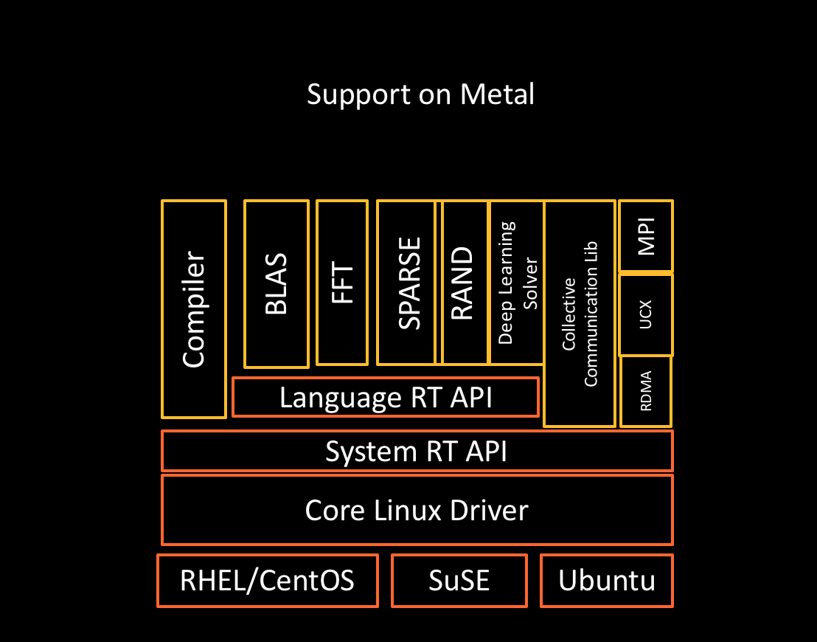
Layer Model of ROCm Stack & Language
Three Level Compilation Foundation & Language Support
LLVM compiler foundation
HCC C++ and HIP for application portability
GCN assembler and disassembler
Notes:
Reference:
GCN Native ISA LLVM Code Generator:
https://rocm-documentation.readthedocs.io/en/latest/ROCm_Compiler_SDK/ROCm-Native-ISA.html
http://llvm.org/docs/AMDGPUUsage.html
Note: The AMDGPU backend provides ISA code generation for AMD GPUs, starting with the R600 family up until the current GCN families. It lives in the lib/Target/AMDGPU directory.

Slide 6
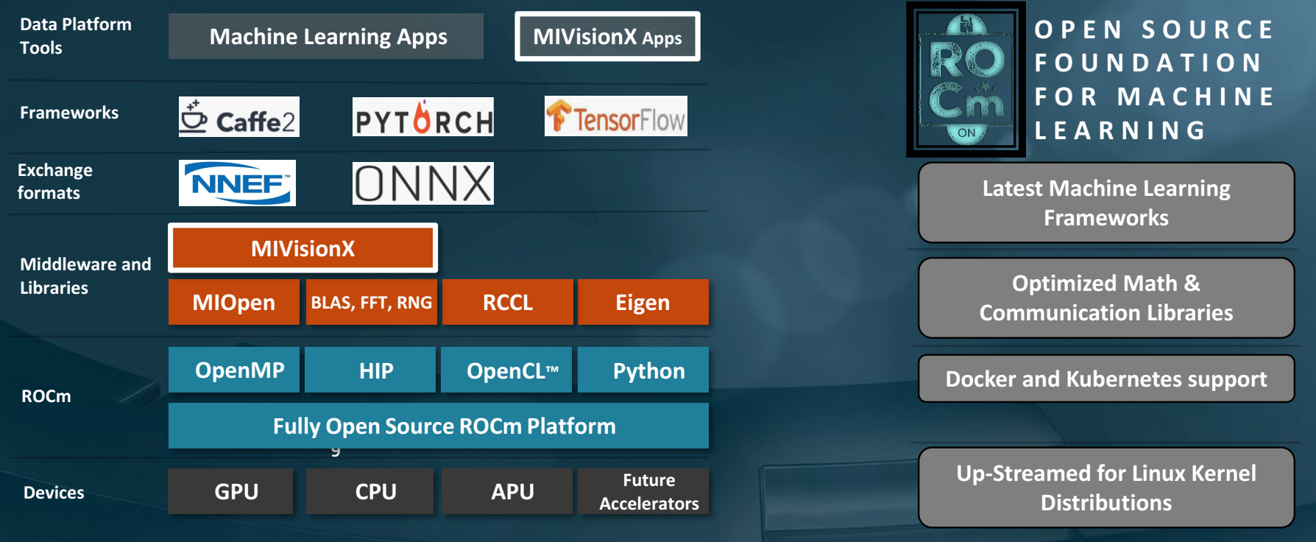
AMD AI over ROCm
Framework | Status | MIOpen Enabled | Upstreamed | Current Repository
Caffe | Public | Yes |  | https://github.com/ROCmSoftwarePlatform/hipCaffe
Tensorflow 2.0 | Verified | Yes | CLA in Progress | Notes: Working on NCCL and XLA enablement, Running
Caffe2 | Upstreaming | Yes | CLA in Progress | https://github.com/ROCmSoftwarePlatform/caffe2
Torch HIP | Upstreaming | Development | In process | https://github.com/ROCmSoftwarePlatform/cutorch_hip
HIPnn | Upstreaming | Development |  | https://github.com/ROCmSoftwarePlatform/cunn_hip
PyTorch | Development | Development
MxNet | Development | Development |  | https://github.com/ROCmSoftwarePlatform/mxnet
CNTK | Development | Development
Notes:
Tensorflow ROCm port This project is based on TensorFlow 1.14.0. It has been verified to work with the latest ROCm2.6 release.
A docker container: rocm/tensorflow:latest(https://hub.docker.com/r/rocm/tensorflow/) is readily available to be used.
PyTorch w/ ROCm Hardware Configuration: A Vega10 / gfx900 generation discrete graphics card is required (Vega56, Vega64, or MI25).
Radeon Vega系列是AMD推出的顯示核心系列。這些卡使用了"Vega"架構，並且搭載HBM2高頻寬記憶體。 Vega是第一個使用第五代GCN架構並且在2018將由Navi架構接替。

Slide 7
Application Development over ROCm Stack
Languages support
HCC: C++ dialect with extensions to express all forms of parallelism, including multicore CPU, SIMD and GPU.
HIP: C++ dialect designed to ease conversion of Cuda applications to portable C++ code.It provides a C-style API and a C++ kernel language.
OpenCL: provides a C run-time API and C99-based kernel language.
Python w/ Numba: Support acceleration of HSA APUs, as well as ROCm-enabled discrete GPUs via Numba that can convert array-oriented and math-heavy Python code to native machine instructions.It supports Python compilation to run on either CPU or GPU hardware and is designed to integrate with Python scientific software stacks, such as NumPy.
GCN Version | GPU/APU Family | Example of Radeon GPU
gfx701 | GFX7 | FirePro W8100, FirePro W9100, Radeon R9 290, Radeon R9 390
gfx801 | Carrizo APU | FX-8800P
gfx803 | GFX8 | R9 Fury, R9 Fury X, R9 Nano, FirePro S9300 x2, Radeon RX 480, Radeon RX 470, Radeon RX 460
gfx900 | GFX9 | Vega10
Notes:
HCC: An open source C++ compiler for heterogeneous devices, that takes a application program that conforms to a parallel programming standards such as C++ AMP (C++ AMP是微软公司基于DirectX 11技术实现的一个并行计算库), HC (C++17 Parallel STL), or OpenMP (一套支持跨平台共享内存方式的多线程并发的编程API), and transforms it into the AMD GCN ISA. The project is based on LLVM (backend) + CLANG (front end). https://github.com/RadeonOpenCompute/hcc/wiki
Reference:
https://gpuopen.com/rocm-do-you-speaka-my-language/

Slide 8
MIVisionX Overview
MIVisionX toolkit is a set of comprehensive computer vision and machine intelligence libraries, utilities, and applications bundled into a single toolkit. AMD MIVisionX delivers highly optimized open source implementation of the Khronos OpenVX™ and OpenVX™ Extensions along with Convolution Neural Net Model Compiler & Optimizer supporting ONNX, and Khronos NNEF™ exchange formats.
MIVisoinX toolkit components:
AMD OpenVX & OpenVX Extensions
Neural Net Model Compiler & Optimizer
Toolkit
Utilities
Notes:
Reference:
https://www.khronos.org/assets/uploads/developers/library/2019-embedded-vision-summit/7%20OpenVX-Tutorials-AMD-Khronos-EVS-Workshop_May19.pdf

Slide 9
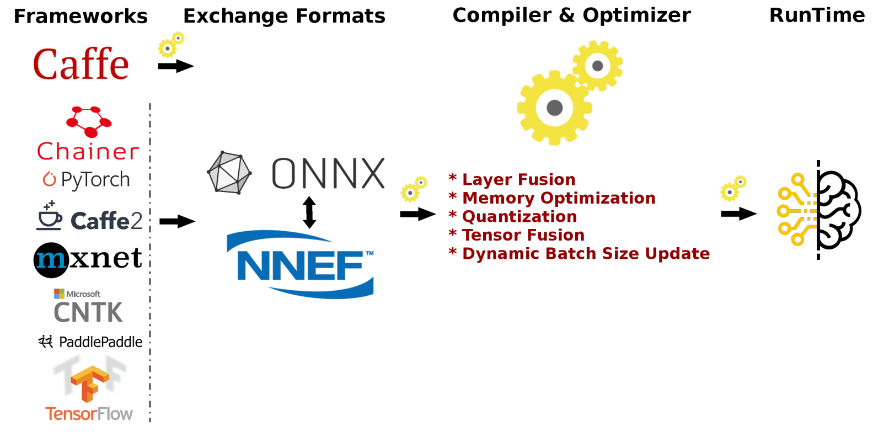
Inference w/ MIVisionX - OpenVX

Slide 10
MIVisionX - AMD OpenVX & OpenVX Extensions
AMD OpenVX Core Lib
vx_loomsl: Radeon LOOM stitching library for live 360 degree video applications
vx_nn: OpenVX neural network module that was built on top of MIOpen (i.e. AMD's cuDNN)
vx_opencv: OpenVX module that implemented a mechanism to access OpenCV functionality as OpenVX kernels
vx_winml: OpenVX module that implemented a mechanism to access Windows Machine Learning(WinML) functionality as OpenVX kernels
Runtime OS: Windows w/ OpenCL SDK, Linux w/ ROCm
Hardware Configuration: CPU: SSE4.1 or above CPU, 64-bit; GPU: Radeon Professional Graphics Cards or Vega Family of Products (16GB required for vx_loomsl and vx_nn libraries)
Notes:
Radeon Loom使用AMDKhronos™OpenVX™开源计算视觉架构，可实时拼接多至24个4k x2k镜头、离线拼接多至31个8K x4K镜头拍摄到的画面。

Slide 11
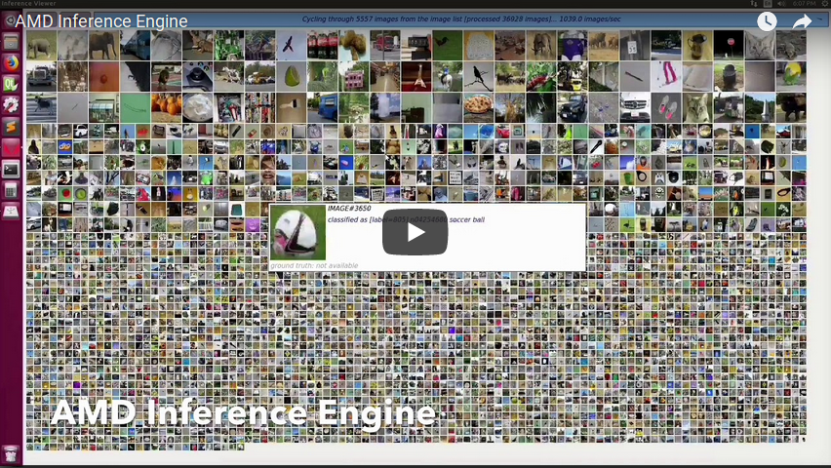
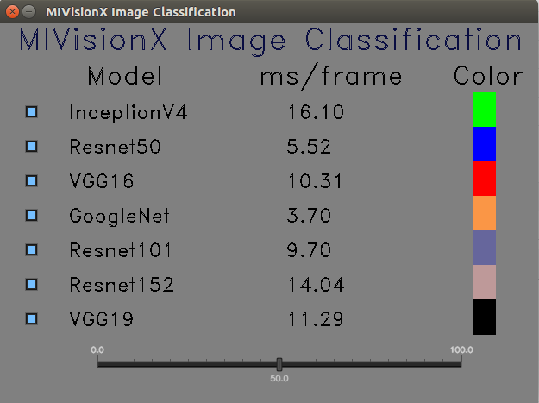
MIVisionX - Applications Based on AMD OpenVX
Cloud Inference Application: This sample application does inference using a client-server system.
Digit Test: This sample application is used to recognize hand written digits.
MIVisionX OpenVX Classsification: This sample application shows how to run supported pre-trained caffe models with MIVisionX RunTime.
MIVisionX WinML Classification: This sample application shows how to run supported ONNX models with MIVisionX RunTime on Windows.
MIVisionX WinML YoloV2: This sample application shows how to run tiny yolov2(20 classes) with MIVisionX RunTime on Windows.
External Applications
Notes:
https://gpuopen-professionalcompute-libraries.github.io/MIVisionX/apps/mivisionx_openvx_classifier/
https://github.com/srohit0/trafficVision#traffic-vision

Slide 12
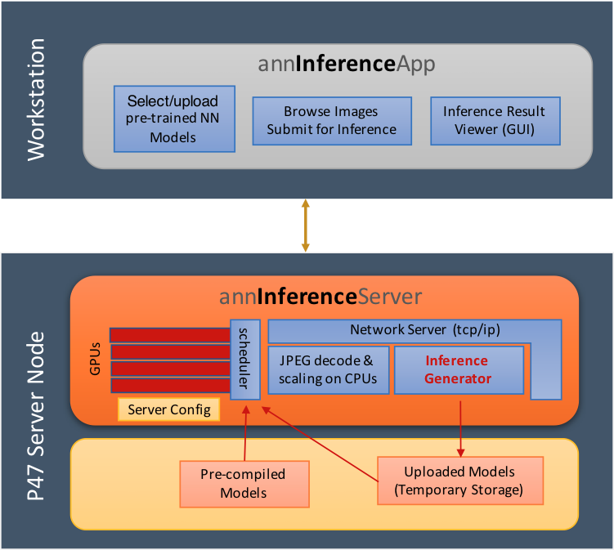
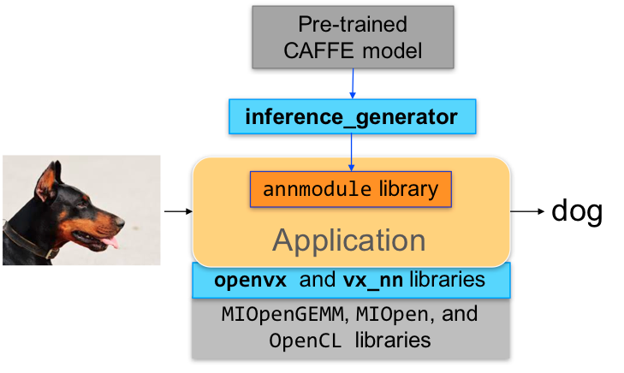
MIVisionX - AMD OpenVX Client/Server Demo App

Slide 13
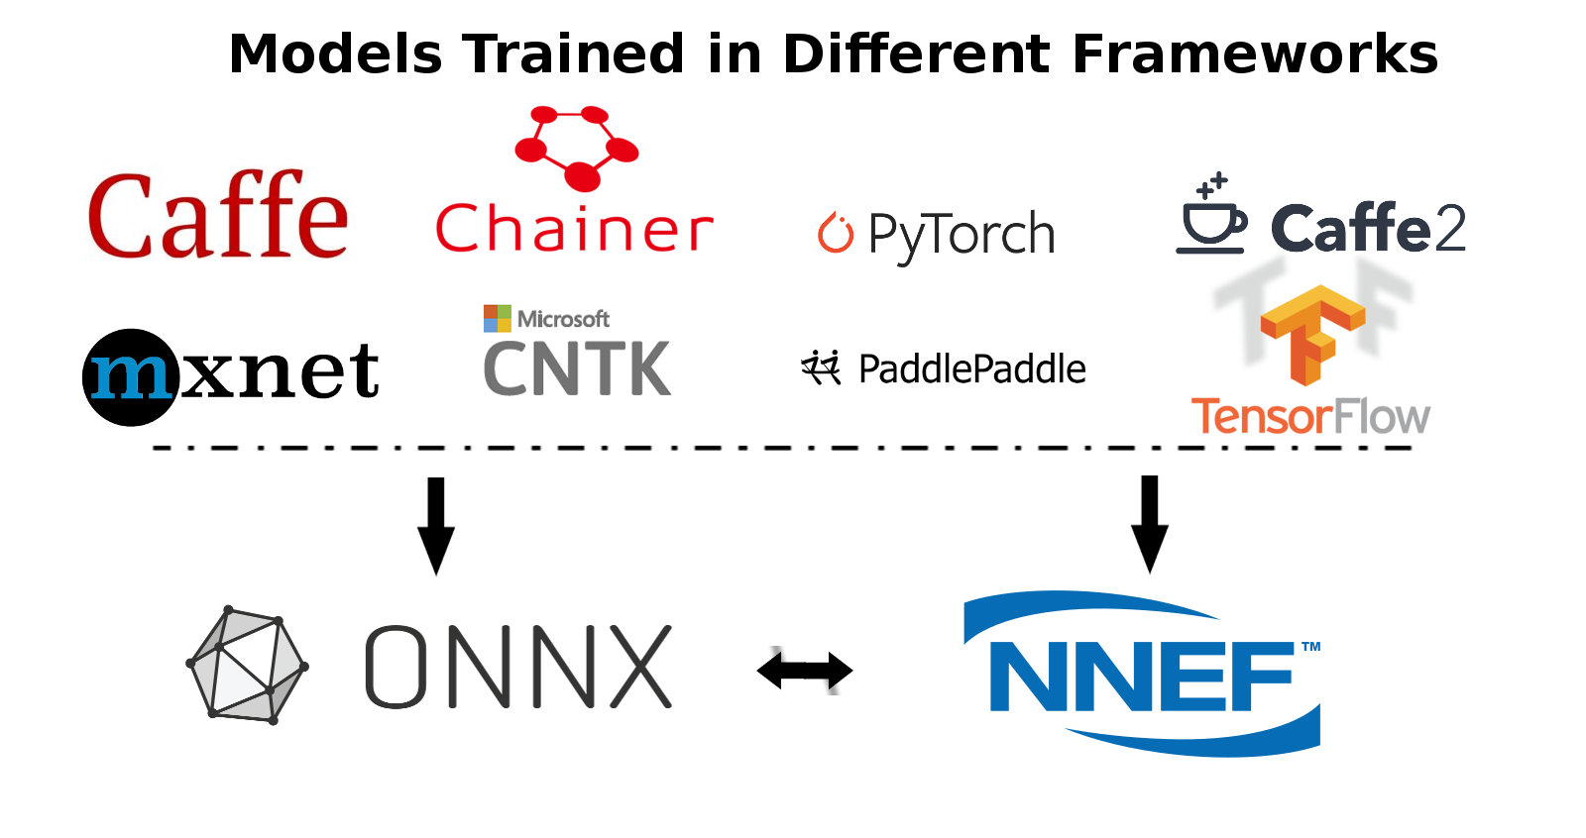
MIVisionX - Neural Net Model Compiler & Optimizer
Neural Net Model Compiler & Optimizer converts pre-trained neural network models to MIVisionX runtime code for optimized inference.
MIVisionX RunTime: AMD OpenVX + OpenCV-Interop Kernels
Pre-requisites: Install ROCm, and MIVisionX, numpy, onnx, nnef-parser
Model Compiler & Optimizer Usage
Step 1 - Convert Pre-trained model to AMD NNIR, pre-trained models can be Caffe, ONNX, NNEF;
Step 2 - Apply Optimizations
Update batch size in AMD NNIR model
Fuse operations in AMD NNIR model
Quantize the model to float 16
Workaround groups using slice and concat operations in AMD NNIR model
Step 3 - Convert AMD NNIR to OpenVX C code w/ nnir_to_openvx.py
Notes:
Models & Operators currently supported:
https://gpuopen-professionalcompute-libraries.github.io/MIVisionX/model_compiler/#mivisionx-runtime

Slide 14
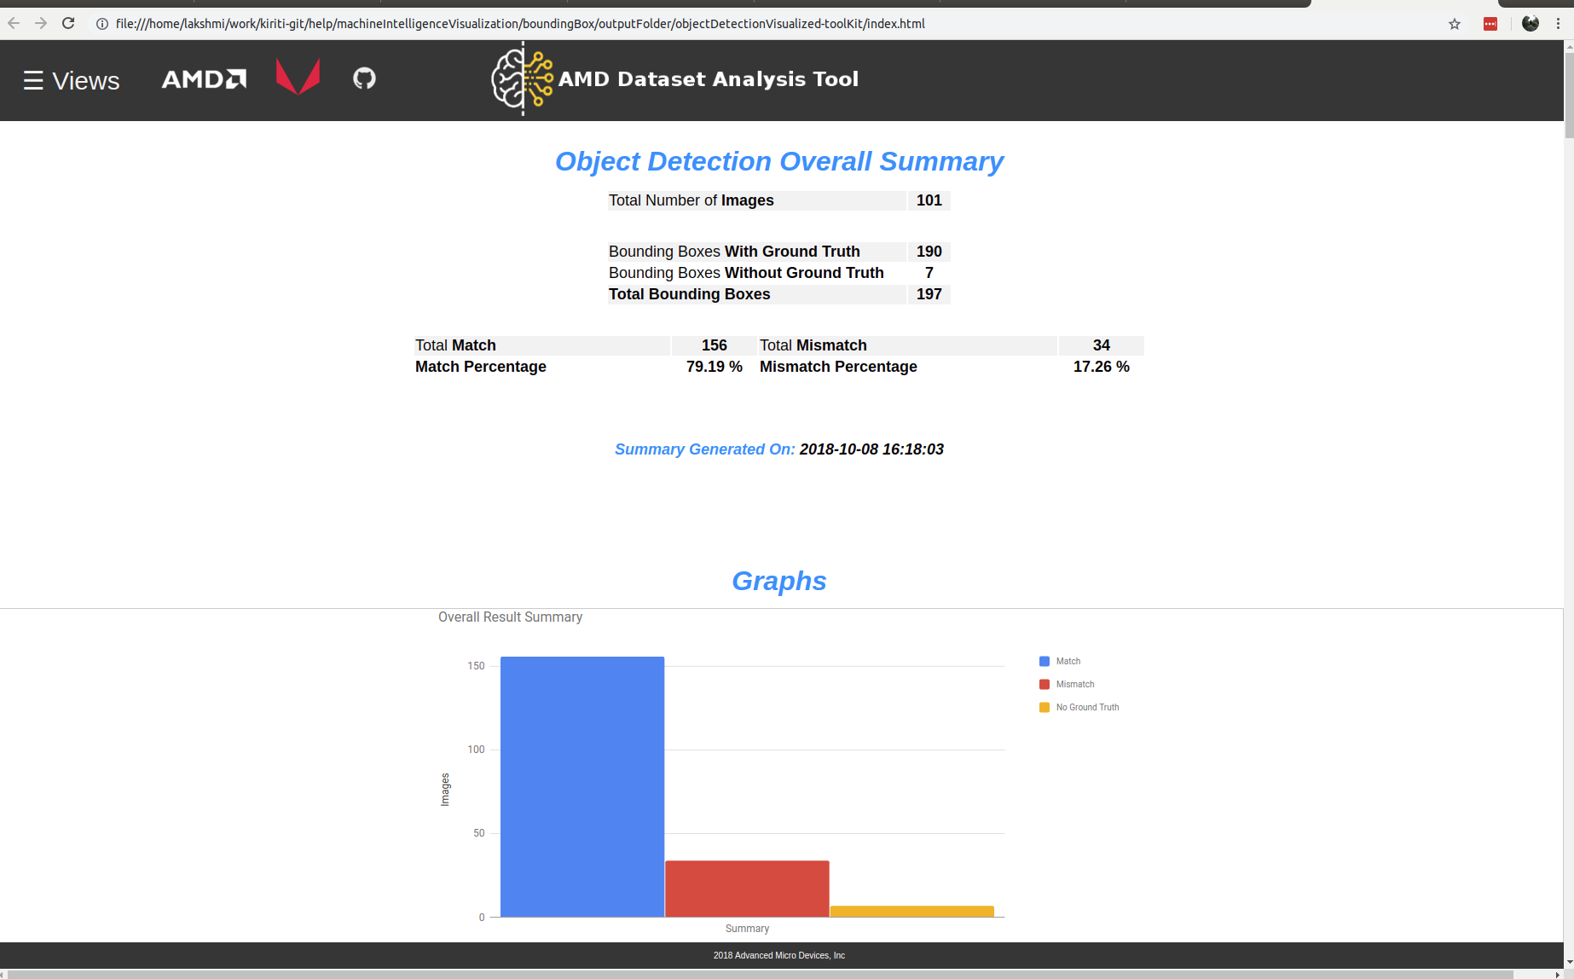
MIVisionX - Toolkit
AMD MIVisionX Toolkit, is a comprehensive set of help tools for neural net creation, development, training and deployment.
Output result
Overall Summary
Graphsgraph
Labels
Image Results
Compare
Model Score

Slide 15
MIVisionX - Utilities
inference_generator: generate inference library from pre-trained CAFFE models
caffe2openvx: Convert a pre-trained CAFFE model into a C library for use by applications.
loom_shell: an interpreter to prototype 360 degree video stitching applications using a script.It provides direct access to Live Stitch API by encapsulating the calls to enable rapid prototyping.
RunVX: command-line utility to execute OpenVX graph described in GDF text file
RunCL: command-line utility to build, execute, and debug OpenCL programs

Slide 16
Backup

Slide 17
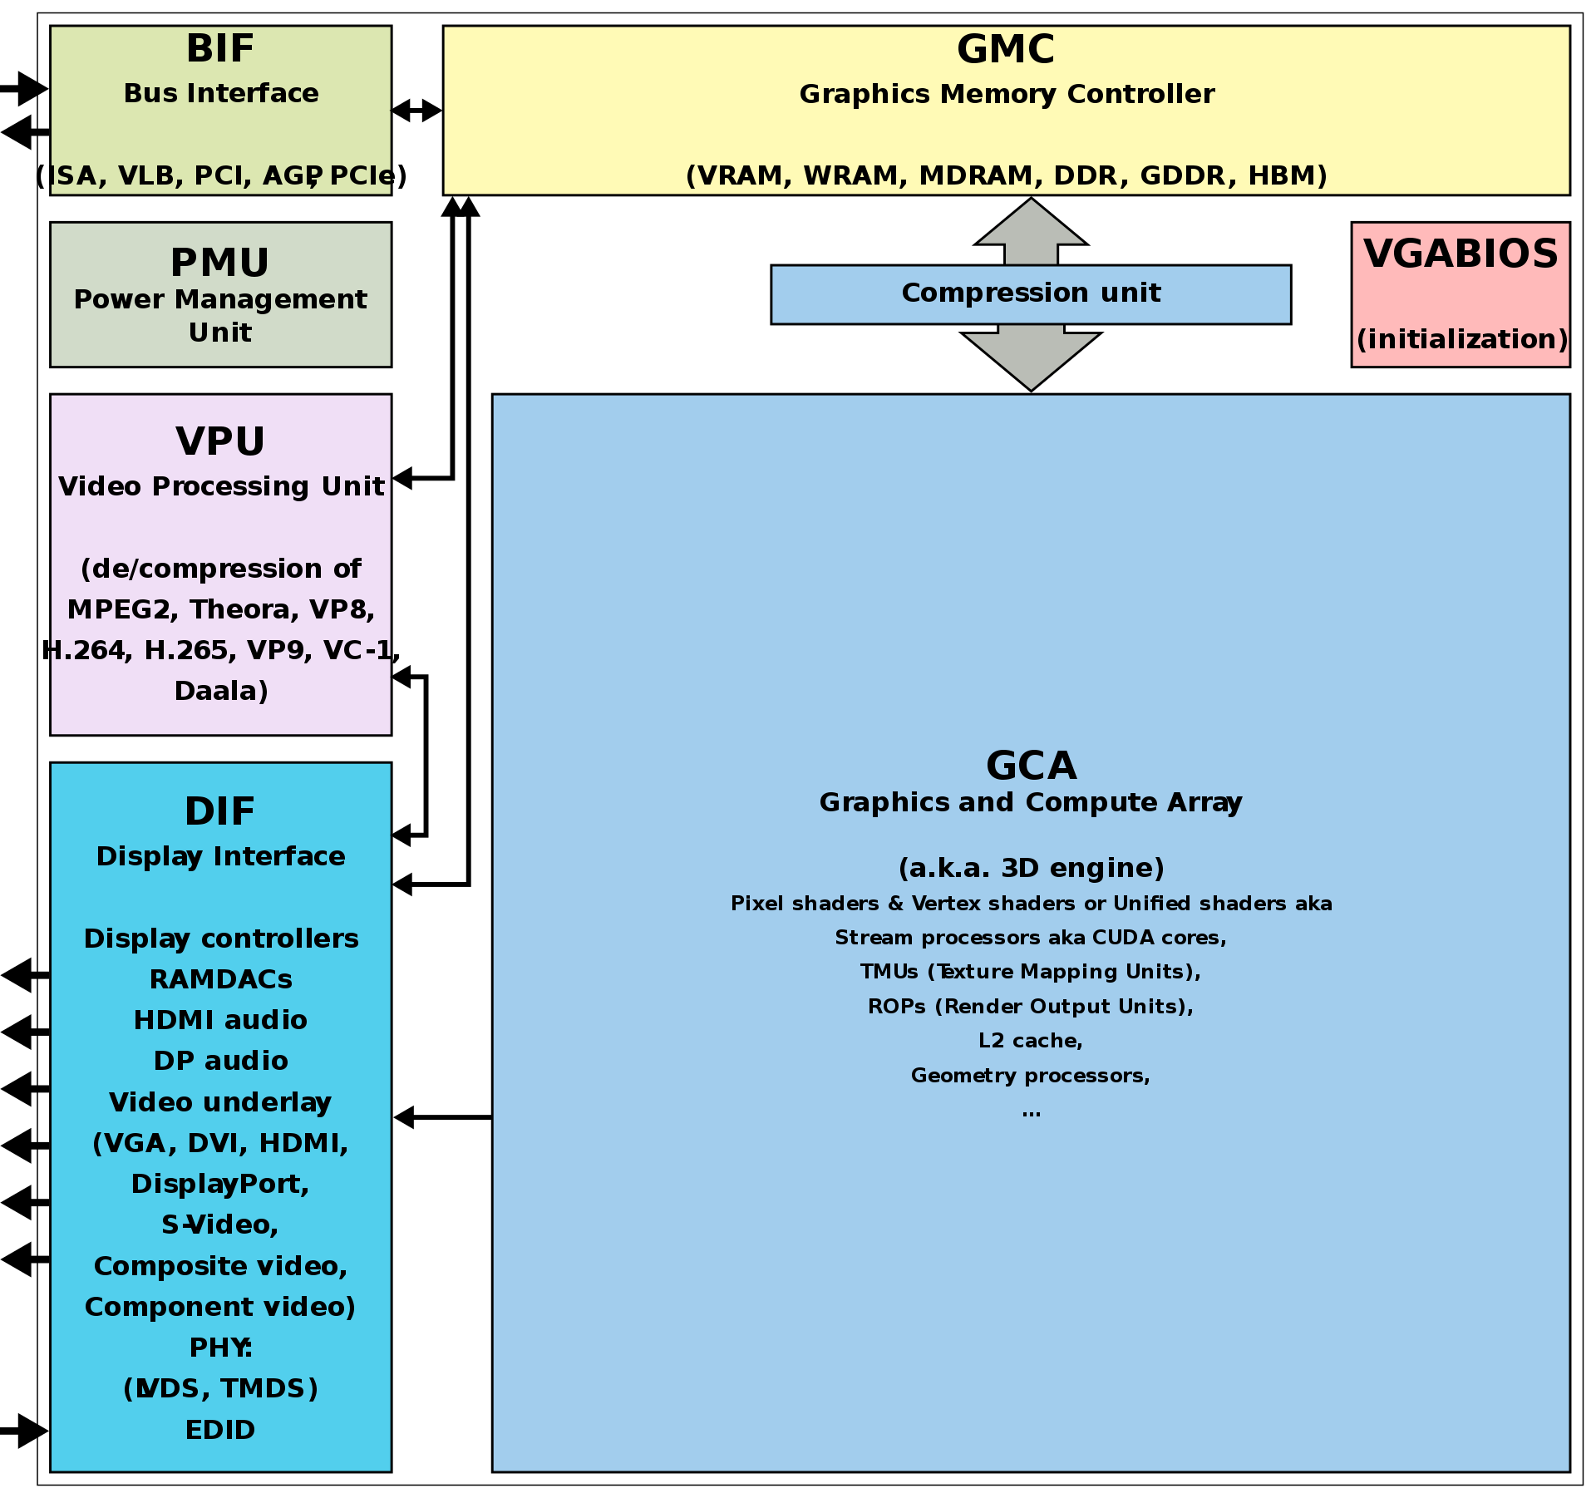
AMD Graphics Core Next
GCN is a RISC SIMD (or rather SIMT) microarchitecture, it has been developed GCN 5th ISA, and Vega ISA.
Highlight GCN 5th Design
Increase instructions per clock, higher clock speeds, support for HBM2, a larger memory address space
Discrete GFX chipsets integrates "HBCC (High Bandwidth Cache Controller)", not in APU
Stream processors support Rapid Pack Math Technology for 8-bit, 16-bit, and 32-bit numbers
All GCN 5th generation GPUs support half-precision floating-point (FP16) calculations which is double of FP32 performance.
Primitive Shaders
Notes:
"Graphics Core Next" shall refer to the entire GPU; hence it is possible that the same version of the GCA (the 3D engine) is combined with different versions of the DIF.
GCN graphics chips are fabricated with CMOS at 28 nm, and with FinFET at 14 nm (by Samsung Electronics and GlobalFoundries) and 7 nm (by TSMC), available on selected models in the Radeon HD 7000, HD 8000, 200, 300, 400, 500 and Vega series of AMD Radeon graphics cards, including the separately released Radeon VII. GCN is also used in the graphics portion of AMD Accelerated Processing Units (APU), such as in the PlayStation 4 and Xbox One APUs.
Chips
discrete GPUs:
Vega 10 (14 nm Samsung/GloFo FinFET process) (also codenamed Greenland[46]) found on "Radeon RX Vega 64", "Radeon RX Vega 56", "Radeon Vega Frontier Edition" and "Radeon Pro V340" graphics cards[47]
Vega 12 (14 nm Samsung/GloFo FinFET process) found on "Radeon Vega Pro 20" and "Radeon Vega Pro 16"-branded mobile graphics cards[48]
Vega 20 (7 nm TSMC FinFET process) found on "Radeon Instinct MI50" and "Radeon Instinct MI60"-branded accelerator cards[49] and "Radeon VII"-branded graphics cards[50].
Integrated into APUs:
Raven Ridge[51] came with VCN 1 which supersedes VCE and UVD and allows full fixed-function VP9 decode.
Rapid Packed Math: Packing two FP16 operations inside of a single FP32 operation in a vec2 style.

Slide 18
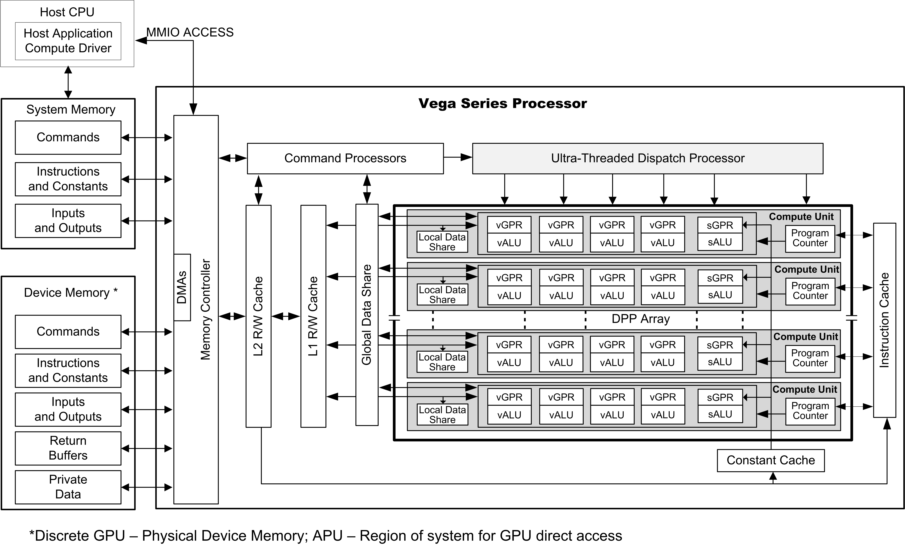
Vega Series Processor
The DPP array is the heart of the GCN processor. The array is organized as a set of compute unit (CU) pipelines operating in parallel on streams of floating-point or integer data.
64 CUs (Compute Units) -- 64 CUs on Vega64. 56 CUs on Vega56.
16kB L1 (Level 1) data-cache per CU
64kB LDS (Local Data Store) per CU
4-vALUs (vector Arithmetic Logic Unit) per CU
16 PE (Processing Elements) per vALU
4 x 256 vGPRs (vector General Purpose Registers) per PE
1-sALU (scalar Arithmetic Logic Unit) per CU
Grand Total: 64 CUs x 4 vALUs x 16 PEs == 4096 "shaders"
64 workitem (parallel elements, also called lane) / wavefront, 16 wavefront / work group, so the max 1024 workitems can be handled in single one instruction (i.e. one pass).
Notes:
Reference:
https://www.reddit.com/r/hardware/comments/acjj8a/musings_on_vega_gcn_architecture/
Vega ISA: https://rocm-documentation.readthedocs.io/en/latest/GCN_ISA_Manuals/testdocbook.html#testdocbook
The GCN device includes a data-parallel processor (DPP) array, a command processor, a memory controller, and other logic (not shown). The GCN command processor reads commands that the host has written to memory-mapped GCN registers in the system-memory address space. The command processor sends hardware-generated interrupts to the host when the command is completed.
Workgroup: A workgroup is a collection of wavefronts that have the ability to synchronize with each other quickly; they also can share data through the Local Data Share.
Wavefront: A collection of 64 work-items that execute in parallel on a single GCN processor.
Work-item: A single element of work: one element from the dispatch grid, or in graphics a pixel or vertex.
With only 16-PEs per vALU, how does a wavefront of size 64 actually work? The dirty little secret is that each PE repeats itself 4-times in a row, across 4-cycles. This is a hidden fact deep in AMD documentation. In any case, 4-cycles x 16 PE == 64 Workitems per vALU. x4 vALUs == 256 work-items per Compute Unit (every 4 clock cycles). Why repeat themselves? Repeating commands over-and-over again helps Vega to hide the memory-latency problem.

Slide 19
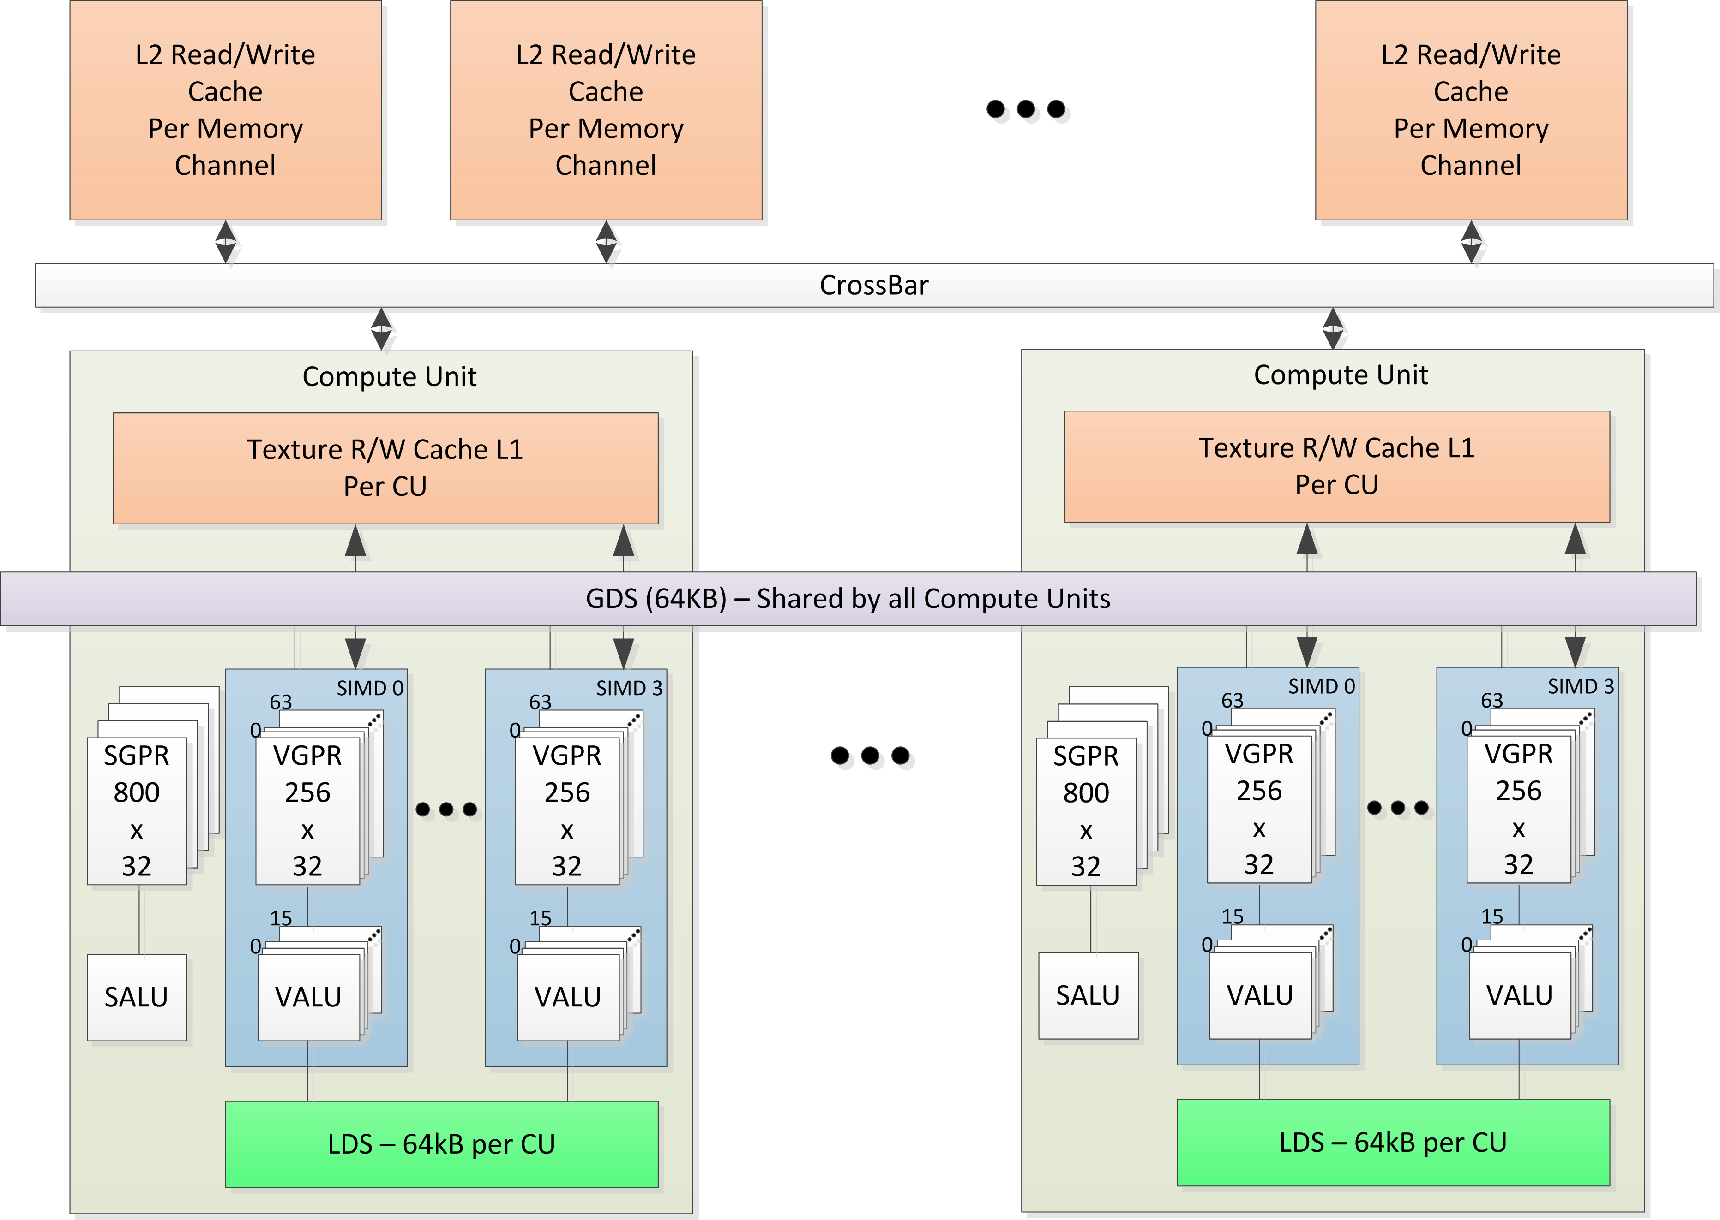
Compute Unit (CU) and Memory Hierarchy
SGPR and VGPR
xGRR bandwidth is (1,050 GHz) * (64 CUs) * (64 lanes) * (12 bytes per lane) = 51.6 TB/s.
Local Data Share (LDS)
LDS is a low-latency RAM physically located on chip in each compute unit (CU), that is configured with 32 banks, each with 512 entries of 4 bytes that enables low-latency communication between work-items within a work-group, or the work-items within a wavefront, w/ (1,050 GHz) * (64 CUs) * (32 LDS banks) * (4 bytes per read per lane) = 8.6 TB/s (R9 Fury X for example)
Global Data Share (GDS)
GDS is configured with 32 banks, each with 512 entries of 4 bytes each.
DS-Permute Instructions support Cross-Lane Operations
ds_permute_b32 and ds_bpermute_b32 . They use LDS hardware to route data between the 64 lanes of a wavefront
ds_swizzle_b32, VOP_DPP modifier, which allows VALU instructions to access data in neighboring lanes
Notes:
Reference:
https://gpuopen.com/amd-gcn-assembly-cross-lane-operations/
https://www.techspot.com/article/1874-amd-navi-vs-nvidia-turing-architecture/
https://www.extremetech.com/gaming/293107-meet-rdna-amds-long-awaited-new-gpu-architecture

Slide 20
Performance Overview of Various CPU and GPU Architecture

Slide 21
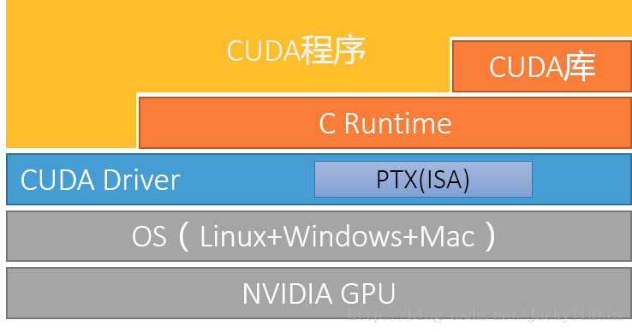
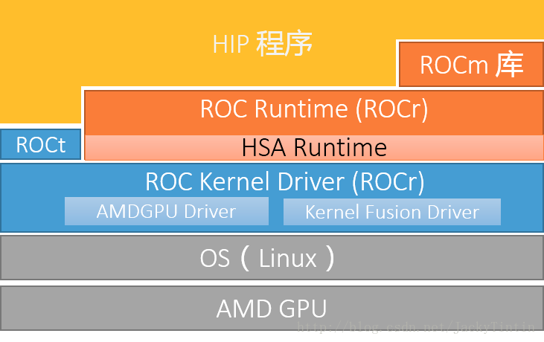
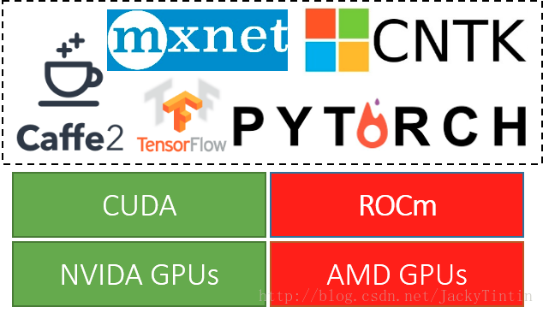
AMD ROCm Overview
ROCm之于AMD GPU，基本上相当于CUDA 之于NVIDIA GPU。
ROCm的目标是建立可替代 CUDA 的生态，并在源码级别上对 CUDA 程序的支持。为了实现目标，ROCm 复制了 CUDA 的技术栈。
Notes:
https://blog.csdn.net/JackyTintin/article/details/74637157
ROCm Software Platform:
https://github.com/ROCmSoftwarePlatform

Slide 22
ROCm vs CUDA
CUDA | ROCm | 备注
CUDA API | HIP | C++ 扩展语法
NVCC | HCC | 编译器
CUDA 函数库 | ROC 库、HC 库
Thrust | Parallel STL | HCC 原生支持
Profiler | ROCm Profiler
CUDA-GDB | ROCm-GDB
nvidia-smi | rocm-smi
DirectGPU RDMA | ROCn RDMA | peer2peer
TensorRT | Tensile | 张量计算库
CUDA-Docker | ROCm-Docker

Slide 23
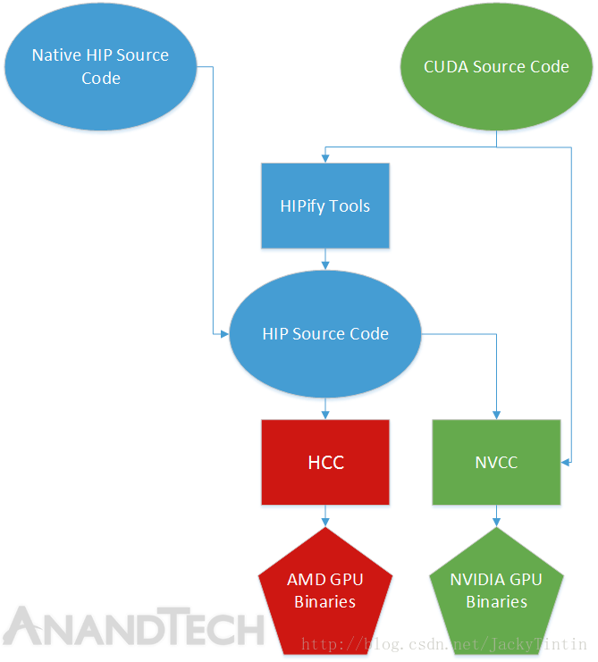
HIP (Heterogeous-compute Interface for Portability，异构计算可移植接口)
HIP 可以说是 CUDA API 的”山寨克隆“版。除了一些不常用的功能（e.g. managed memory）外，几乎全盘拷贝 CUDA API，是 CUDA 的一个子集。
AMD 提供的 HIPify 工具，核心只是一个 perl 脚本，主要功能就是查找与替换。
HCC 是 基于 CLANG/LVVM 的开源编译器，是 ROCm 中 NVCC 的对应工具。相比于 NVCC，HCC 的提供了更多的功能 。HCC 单一编译环境统一支持 ISO C++ 11/14、C14、OpenMP 4.0，并且前向性的支持 C++17 “Parallel STL”，兼容 C++ AMP（微软推出的并行计算 API 标准），而且是同时适用于CPU、GPU。
rocBLAS 接口上兼容 Netlib BLAS 和 cuBLAS-v2 API。
随机数库 hcrng（HC Random Number Generator）
rocFFT 接口设计上与 clFFT 一致。

Slide 24
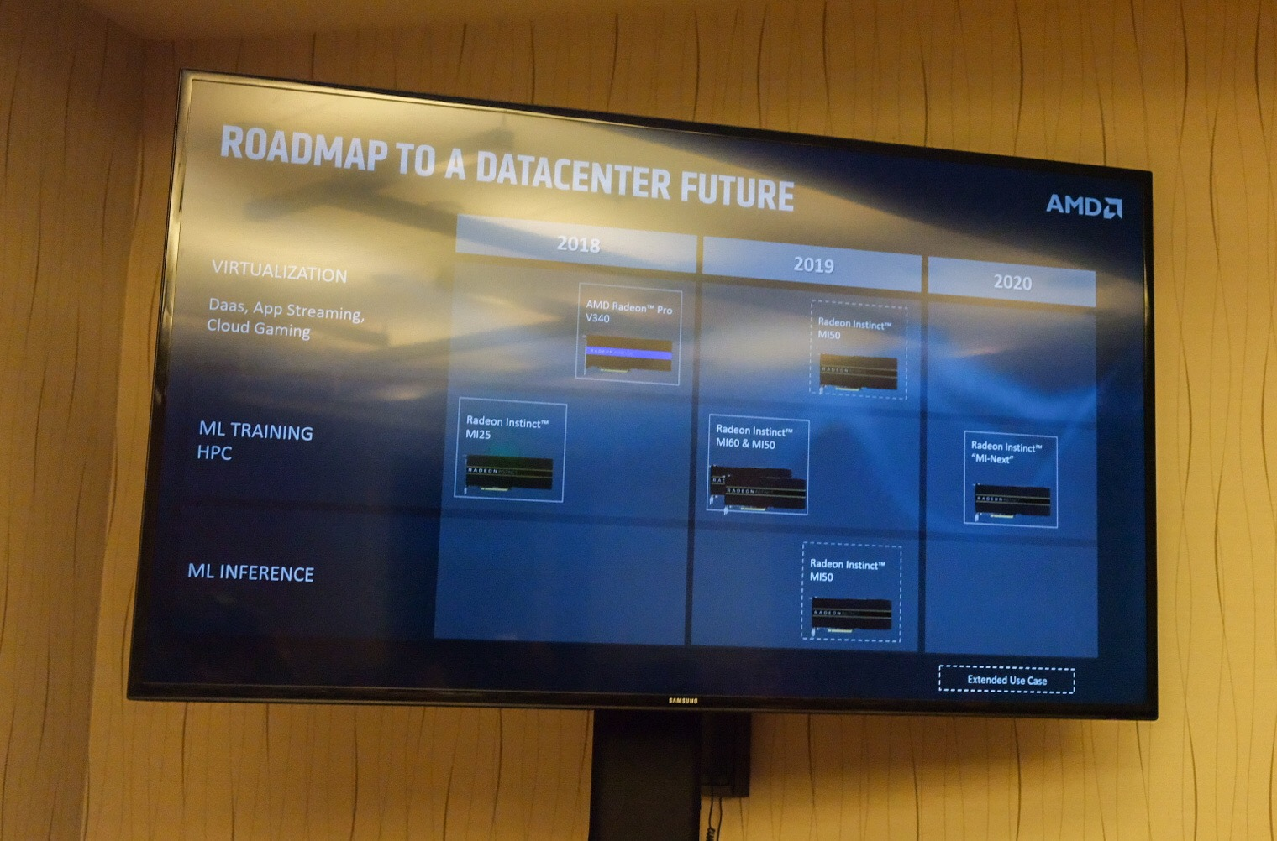
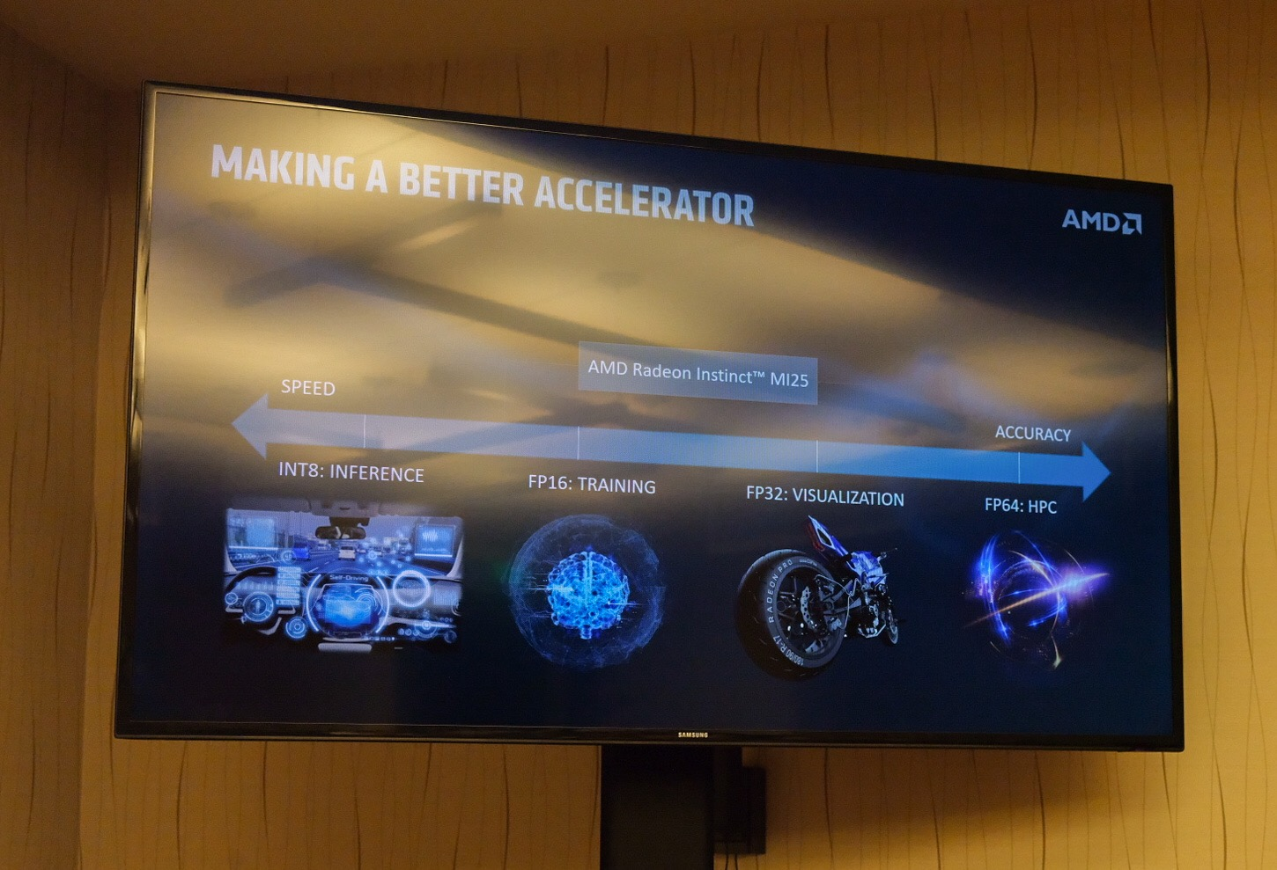
Notes:
https://www.coolaler.com/threads/amd-next-horizon7nm.353166/

Slide 25
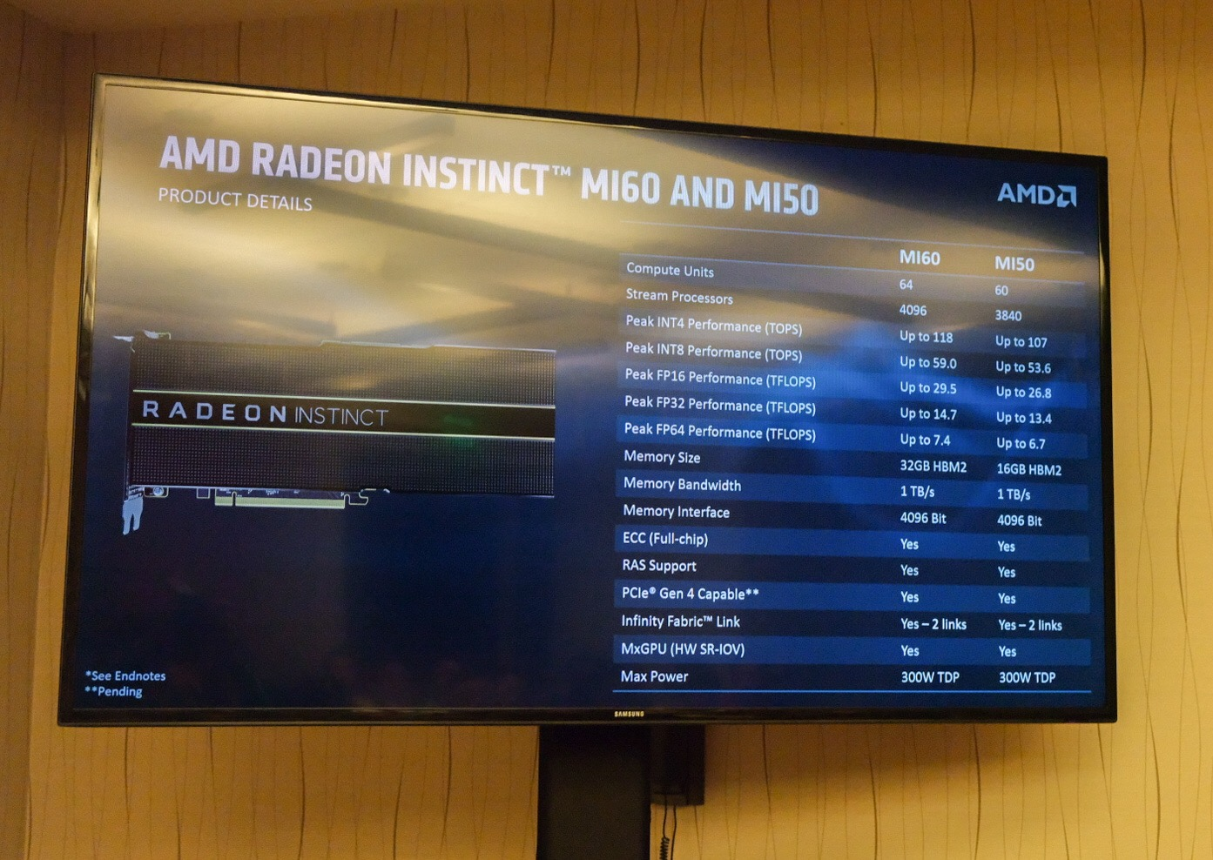
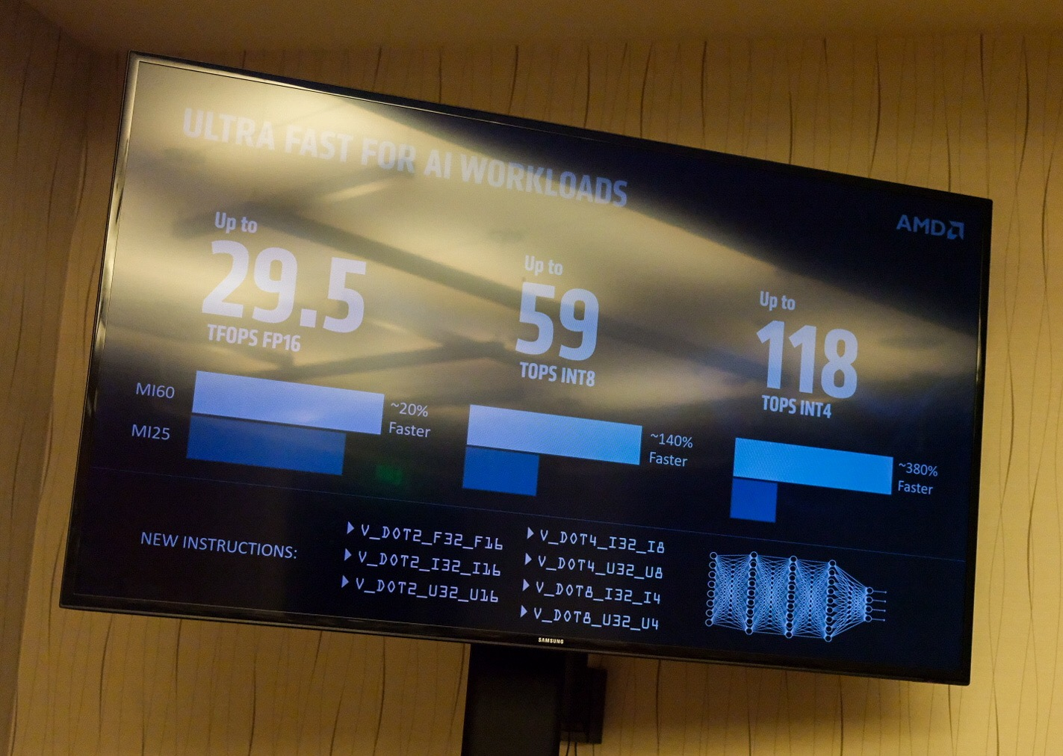

Slide 26
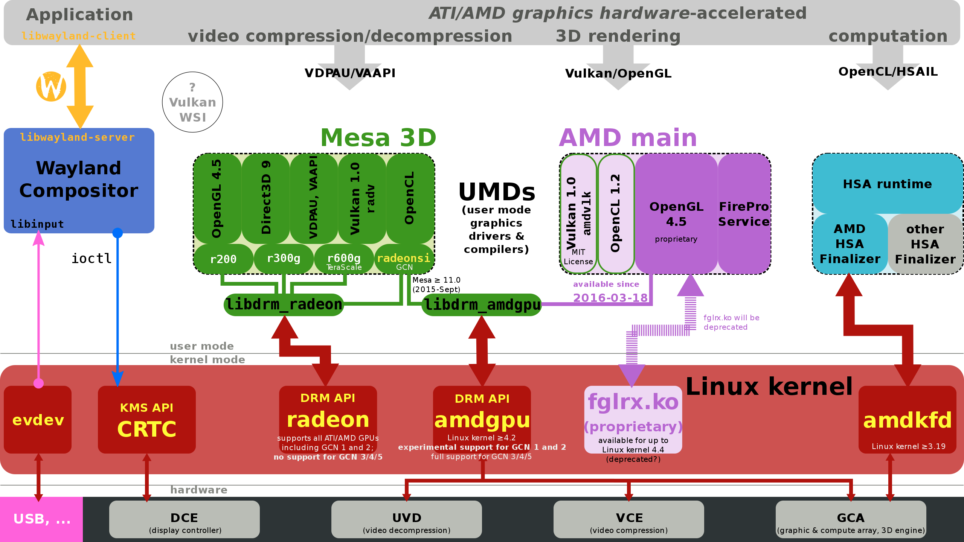
HSA support in AMD GPUs & Software
Notes:
Reference:
GCN Native ISA LLVM Code Generator -- https://rocm-documentation.readthedocs.io/en/latest/ROCm_Compiler_SDK/ROCm-Native-ISA.html

Slide 27
Heterogeneous system architecture (HSA)
HSA is a set of platform architecture features and a programming model that software can depend on for parallel computing.
Security and “quality of service”
An HSA accelerator has a “user mode” ingrained for execution, where the operating system (OS) runtime sets strict policies at the hardware level for the accelerator.
Shared virtual memory (SVM)
Requires an MMU in hardware. SVM allows the accelerator to parse and only access the application data it needs directly.
Platform atomic operations
HSA compatible accelerators must support 32-bit or 64-bit atomics, as threads running on the CPU and on the accelerator operate and synchronize with each other very efficiently using atomic operations.
HSA signals and doorbells
By using HSA signals, one accelerator can notify other accelerators directly that data is ready and these can start their processing immediately. If implemented fully, the CPU doesn’t need to perform any coordination and can stay asleep. This is a significant power saving feature.
User queues and dispatch
Defining a hardware-based user queue dispatch mechanism that can be directly accessed from the application runtime.
Cache coherency
Cache coherency can be automatically enforced by hardware bus protocols or alternatively require instruction controls, which in the case of HSA is part of the definition.

Slide 28
THANK YOU

